Slide 1
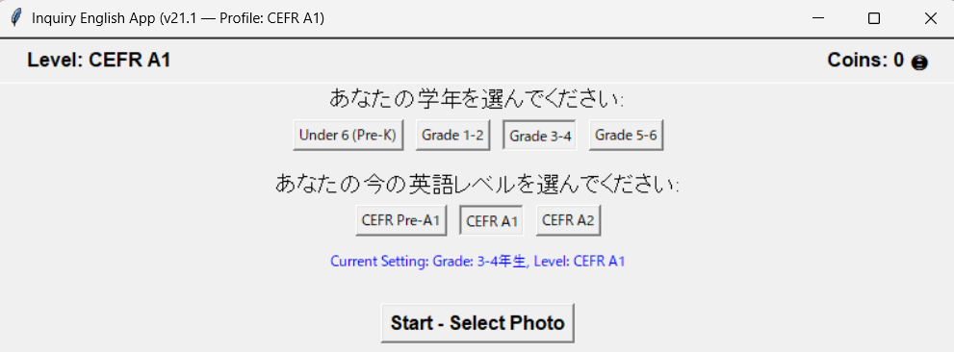
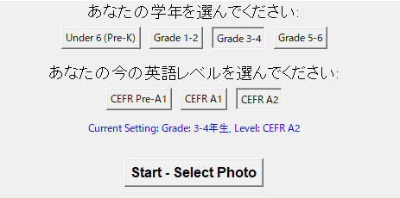
平松大河
英語レベルの選択
Choose your English level
①
②

Slide 2
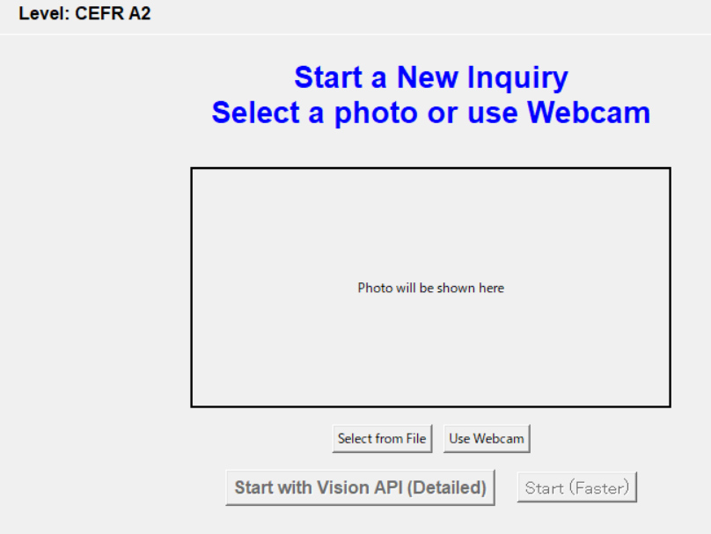
写真撮影
photo shoot
<< choose one

Slide 3
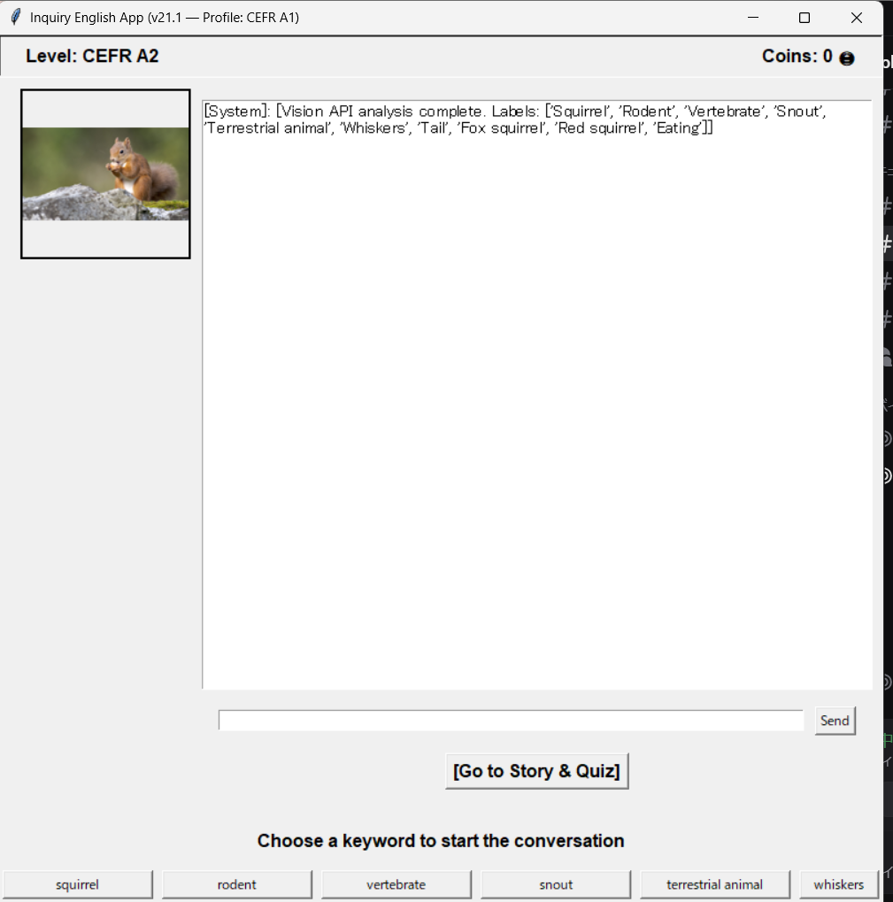
単語の提示・選択
Word presentation and selection
Google Vision
presentation
<< Recognition information
choice

Slide 4
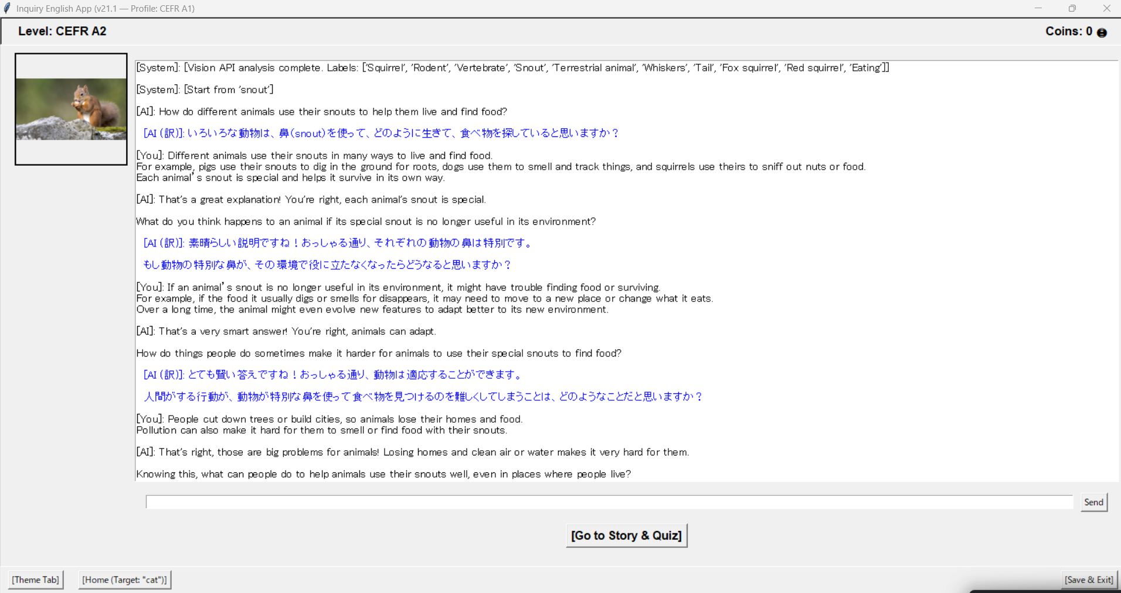
会話 conversation
input
Talk until pressed

Slide 5
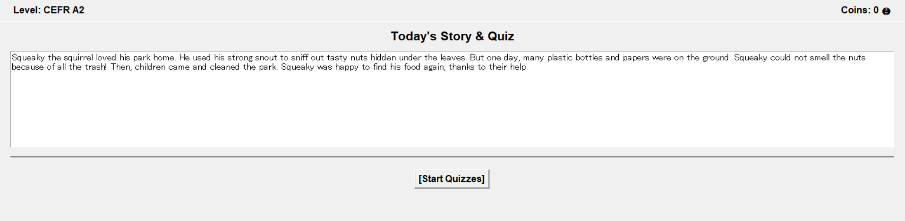
会話から生成された記事
Articles generated from conversations
Press to see the problem

Slide 6
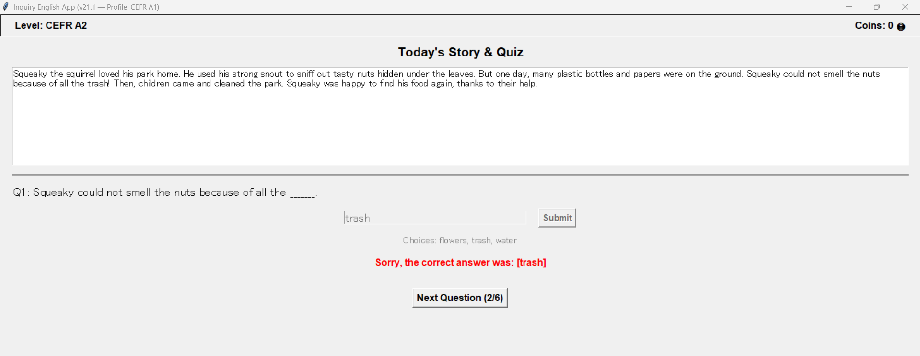
問題１
Problem 1

Slide 7
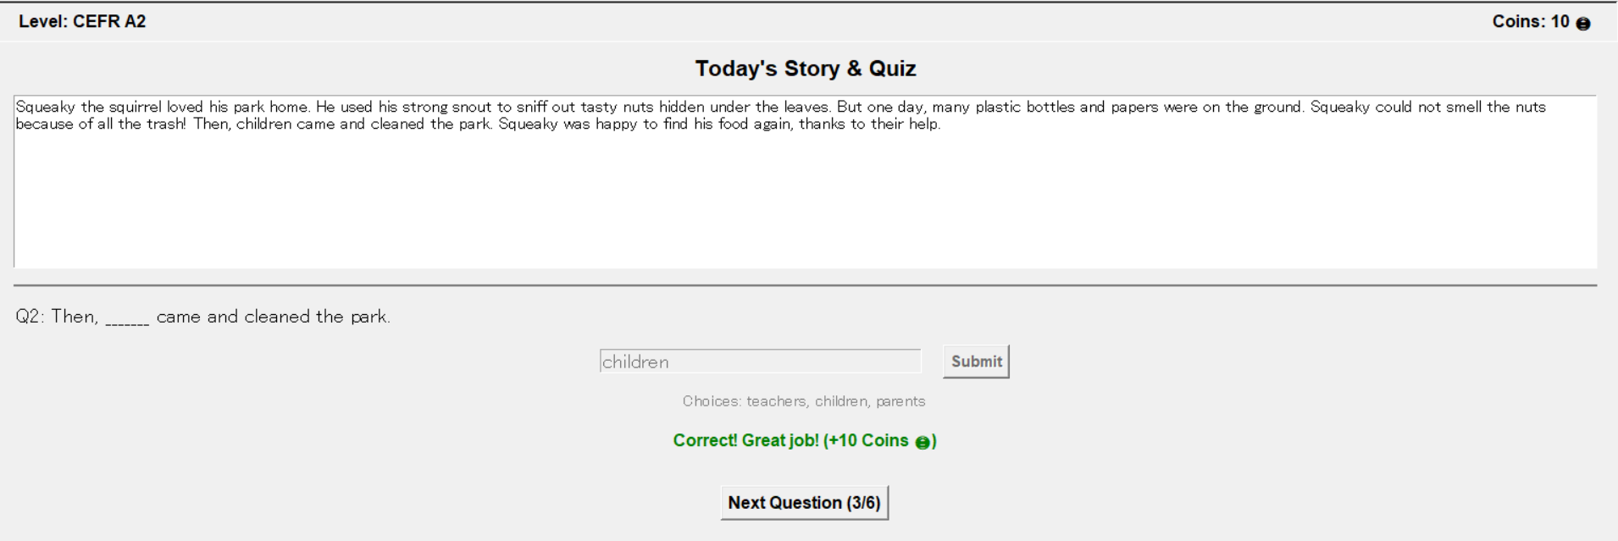
問題２
Problem 1
コインゲット

Slide 8
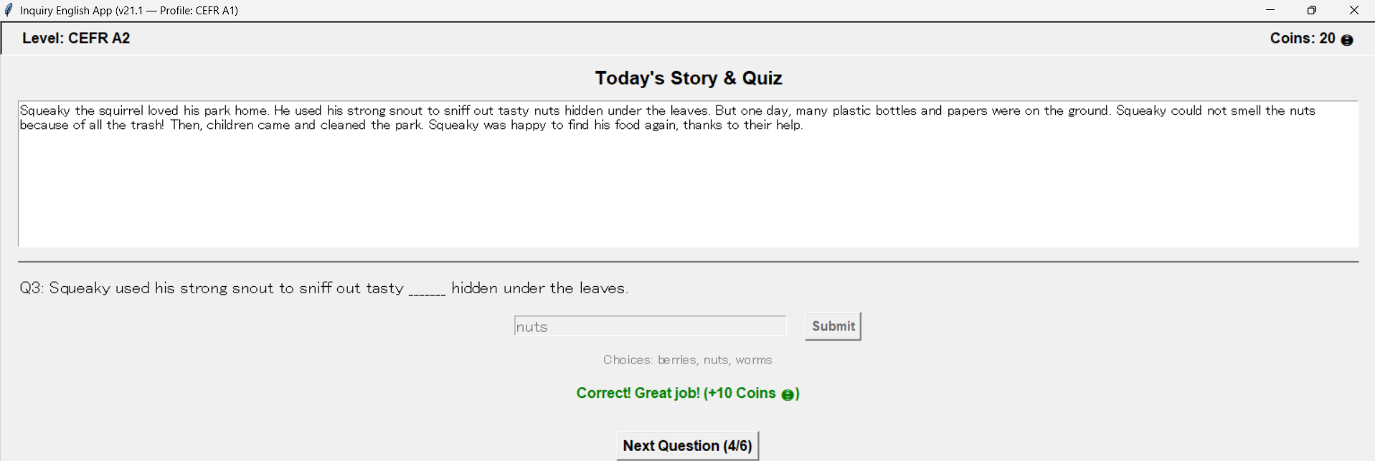
問題３
Problem 2

Slide 9
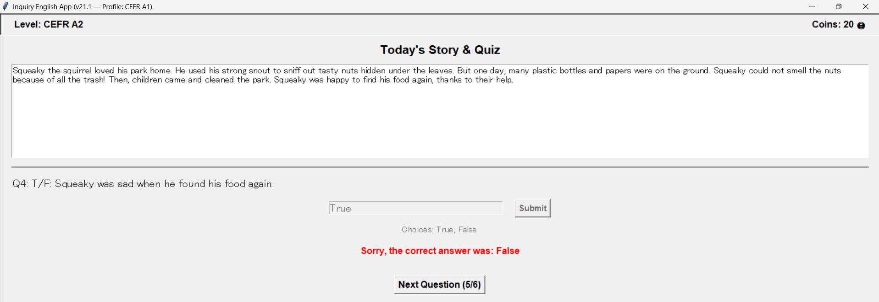
問題４
Problem 3

Slide 10
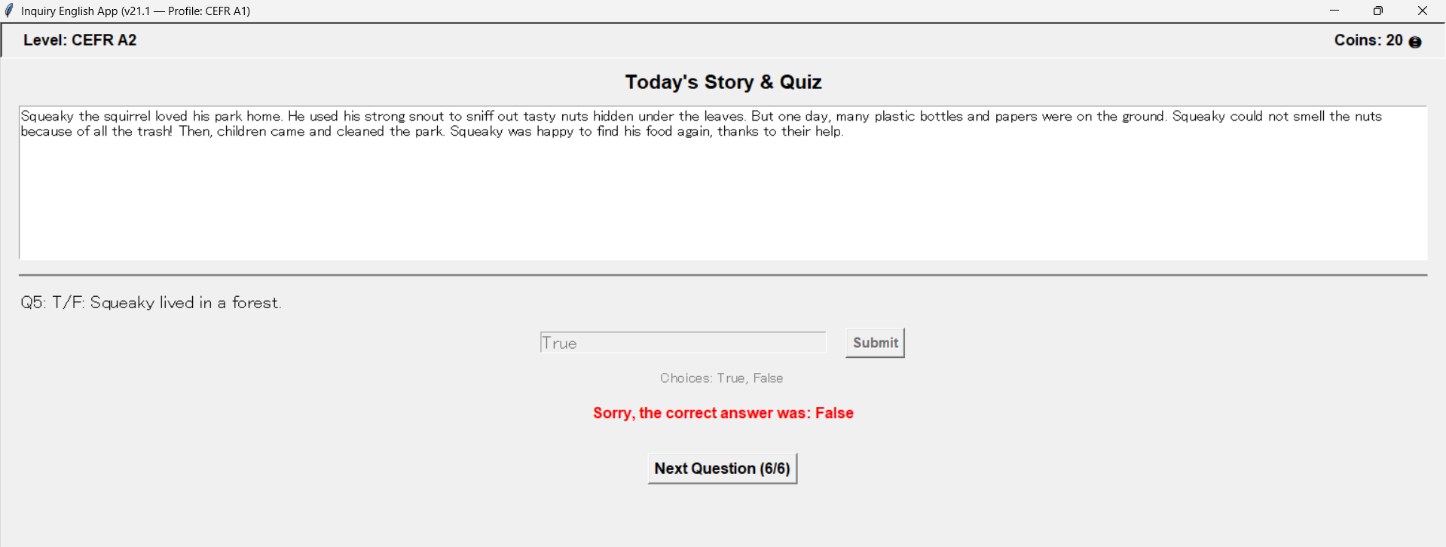
問題５
Problem 4

Slide 11
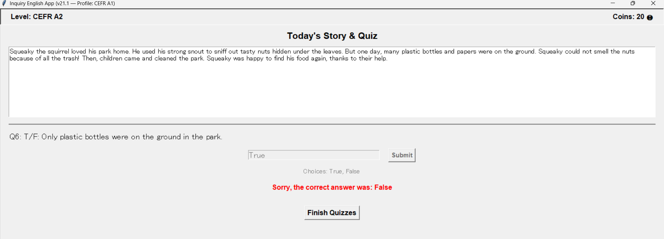
問題６
Problem 5

Slide 12
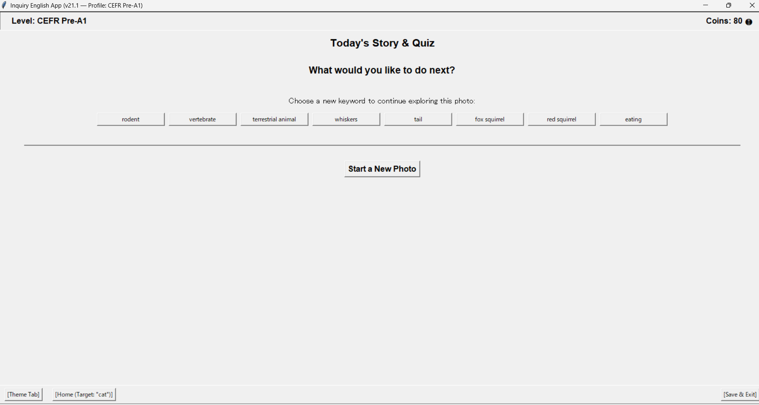
Select words for the next unit (selected from words in the article)
単語選択：p3の画面に移行し、再び会話からスタート
Move to the page 3 screen and start the conversation again.
p13の画面(学習の振り返りの画面に移行)
Page 13 screen (moves to the learning review screen)

Slide 13
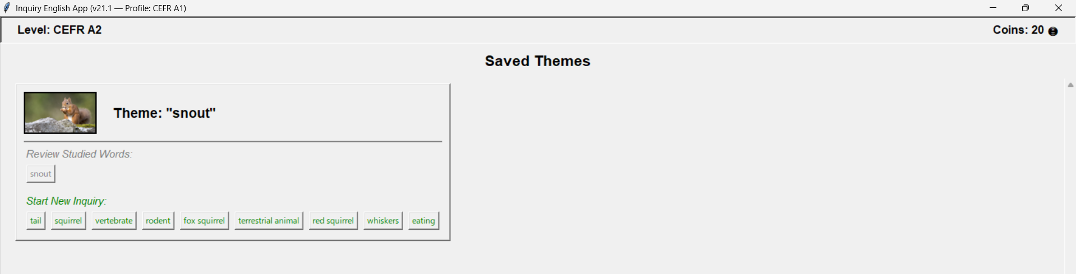
You can also start a new unit from automatically saved theme cards (words Vision reads at the start of the unit)

Slide 14
Words from completed units are grayed out so you can review your learning

Slide 15
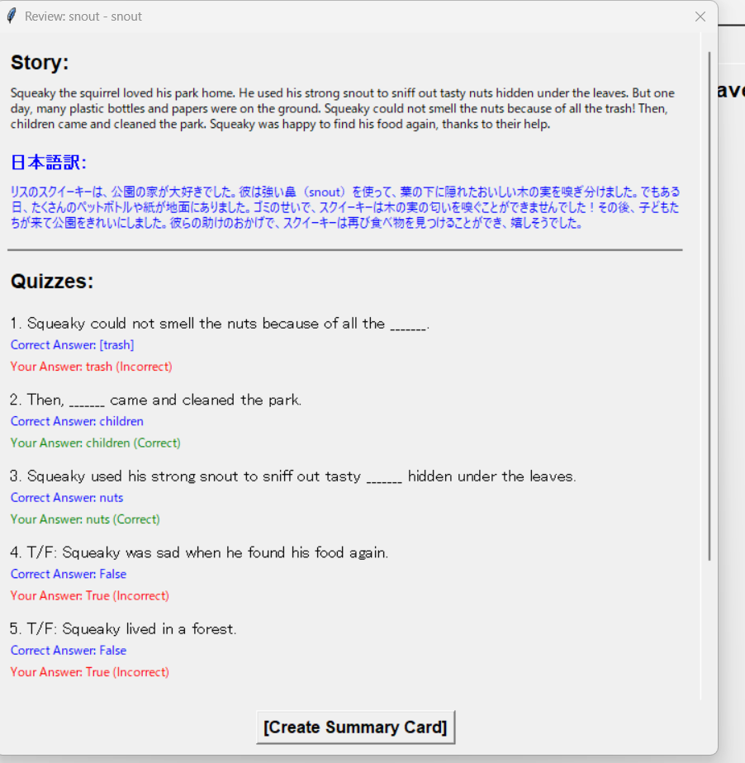
You can review the articles, questions, and answers you have created. Here you can press the “Create Summary Card” button.

Slide 16
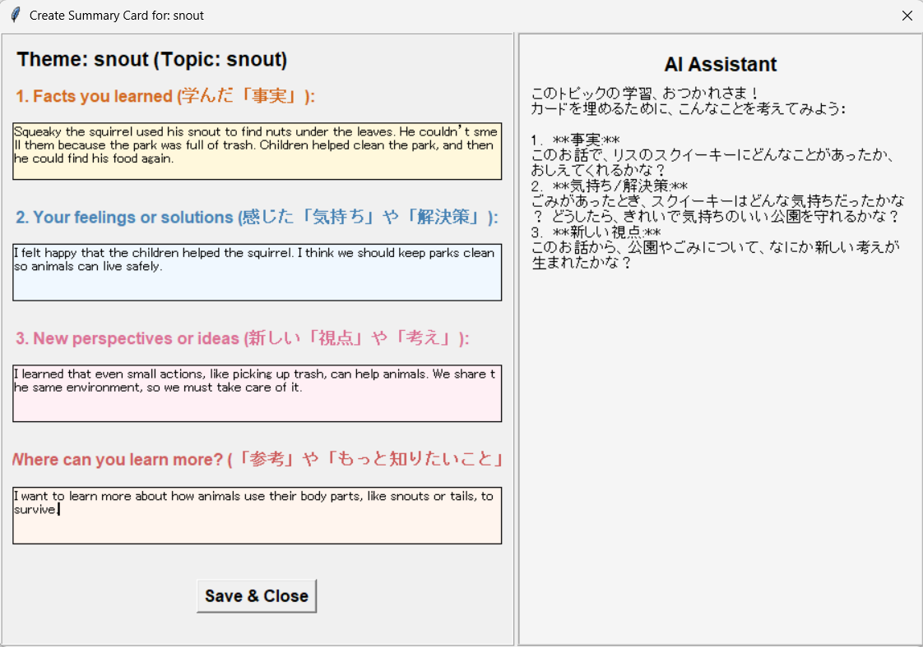
まとめ
summary
Student input

